Slide 1

Getting Started with AI & Data Science
Youssef Hosni

Slide 2



Agenda
Three Steps to Start Your Career
Learning
Essential Skills
Where to Learn?
Focus on the basics & Master One Skill
Developing Learning Habits?
Show Up Your Skills
4 Methods to show your skills
Approaching AI Projects
Building Portfolio Projects
Land a Job
How to Land a Job?
Keys to Building Successful Career
Final Thoughts
Overcoming Imposter Syndrome
Make Everyday Count

Slide 3

AI is the new electricity. It will transform and improve all areas of human life
Andrew NG – Founder of Deep Learning.ai

Slide 4

Three Steps to Start Your Career

Slide 5



Three Steps to Start Your Career
Learning: Initially, you focus on learning foundational skills.
Show up Your Skills: After having gained foundational technical skills, you will begin working on show up your skills.
Job Searching: Later, you will work on finding a job. Throughout this process, you’ll continue to learn and work on meaningful projects.

Slide 6

Learning

Slide 7





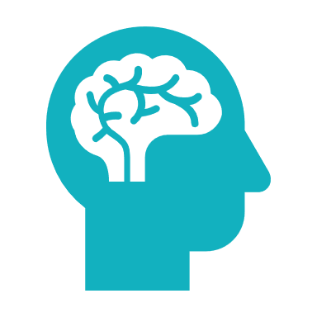

Essential Skills
Software Development
Mathematics
Data Related Skills
Foundational Machine Learning Models
How Machine Learning Models Work
Deep Learning & Generative AI
Machine Learning Operations (MLOps)

Slide 8

Software Development
While you can get a job and make huge contributions with only machine learning modelling skills, your job opportunities will increase if you can also write good software to implement complex AI systems.
These skills include:
Programming fundamentals
Clean & robust code
Data structures (especially those that relate to machine learning, such as data frames)
Algorithms (including those related to databases and data manipulation),
Software System design
Version Control
Python key libraries such as TensorFlow or Pytorch, Scikit-learn, Numpy, and Pandas.
My recommendation:
Python for Everyone Specialization
Software engineering for data scientist

Slide 9

Mathematics
Mathematics are the foundation of machine learning and deep learning algorithms, so it is important to have strong mathematical background in theses areas:
Linear algebra (vectors, matrices, and various manipulations of them)
Probability and statistics (including discrete and continuous probability, standard probability distributions, basic rules such as independence and Bayes’ rule, and hypothesis testing).
Basic intuitive understanding of calculus
In addition, exploratory data analysis (EDA) — using visualizations and other methods to systematically explore a dataset — is an underrated skill.
The math needed to do machine learning well has been changing. For instance, although some tasks require calculus, improved automatic differentiation software makes it possible to invent and implement new neural network architectures without doing any calculus. This was almost impossible a decade ago.
My recommendation: Mathematics for Machine Learning

Slide 10

Data Related Skills
Since you will be working with data, it is important to have hands-on skills in using the data effectively for your models. This includes:
Data collection
Data cleaning
Data Exploration
Feature engineering
My recommendation:
SQL & Database Roadmap
Train in Data Courses

Slide 11

Foundational Machine Learning Models
it’s important to have very good understanding for basic models machine learning models such as linear regression, logistic regression, neural networks, decision trees, clustering, and anomaly detection.
My recommendation: Machine Learning Specialization

Slide 12

How Machine Learning Models Work
Beyond specific models, it’s even more important to understand the core concepts behind how and why machine learning works, such as bias/variance, cost functions, regularization, optimization algorithms, and error analysis.
My recommendation: Machine Learning Specialization

Slide 13

Deep Learning
Deep learning became such a large fraction of machine learning that it’s hard to excel in the field without some understanding of it! It’s valuable to know the basics of neural networks, practical skills for making them work (such as hyperparameter tuning), convolutional networks, sequence models, and transformers.
My recommendation:
Deep Learning Specialization
TensorFlow Developer Professional Certificate

Slide 14
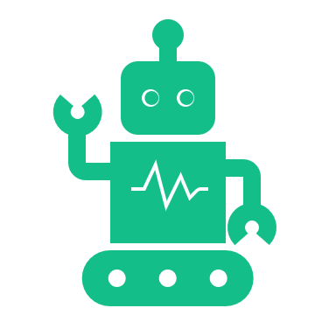
Generative AI
Generative AI is now a hot topic in the AI industry and having the basics of it under your belt will increase your opportunity of landing a position and will open more doors to you.
My recommendation:
Generative AI for Everyone
Generative AI with Large Language Models
Training & Fine-Tuning LLMs for Production

Slide 15

Practical Machine Learning
It is become more important to deploy the models into production and monitor them after that.
My recommendation:
Machine Learning Engineering for Production (MLOps) Specialization
Practical Data Science on the AWS Cloud Specialization
MLOps Learning Roadmap

Slide 16
Focus on Foundations Only
It is very important to only focus on building the foundations in this phase.
Do not try to master everything and know every details about every topic.
You can deepen your knowledge after that as needed

Slide 17
Master One of The Following
Time Series Analysis & Forecasting
Top Time Series Courses
Guided Time Series Projects
Computer Vision
Computer Vision Free Study Roadmap
Computer Vision Guided Projects
NLP & LLM Applications
Large Language Model Course
Guided Large Language Models Projects

Slide 18
From Where To Learn?
There’s a lot of good content on the internet, and in theory, they could work. But when the goal is deep understanding, they will be inefficient because they tend to repeat each other, use inconsistent terminology (which slows you down), vary in quality, and leave gaps.
That’s why a good course in which a body of material has been organized into a coherent and logical form is often the most time-efficient way to master a meaningful body of knowledge. My recommendation is:
Solid textbooks
Coursera & Udacity
University open courses
When you’ve absorbed the knowledge available in courses, you can switch over to research papers and more advanced resources.

Slide 19

Developing Learning Habits
Given how quickly our field is changing, there’s little choice but to keep learning if you want to keep up.
Developing a daily learning habit is a must to be able to keep up with the advances in the filed.
More Information read:
Atomic Habits
Tiny Habits

Slide 20
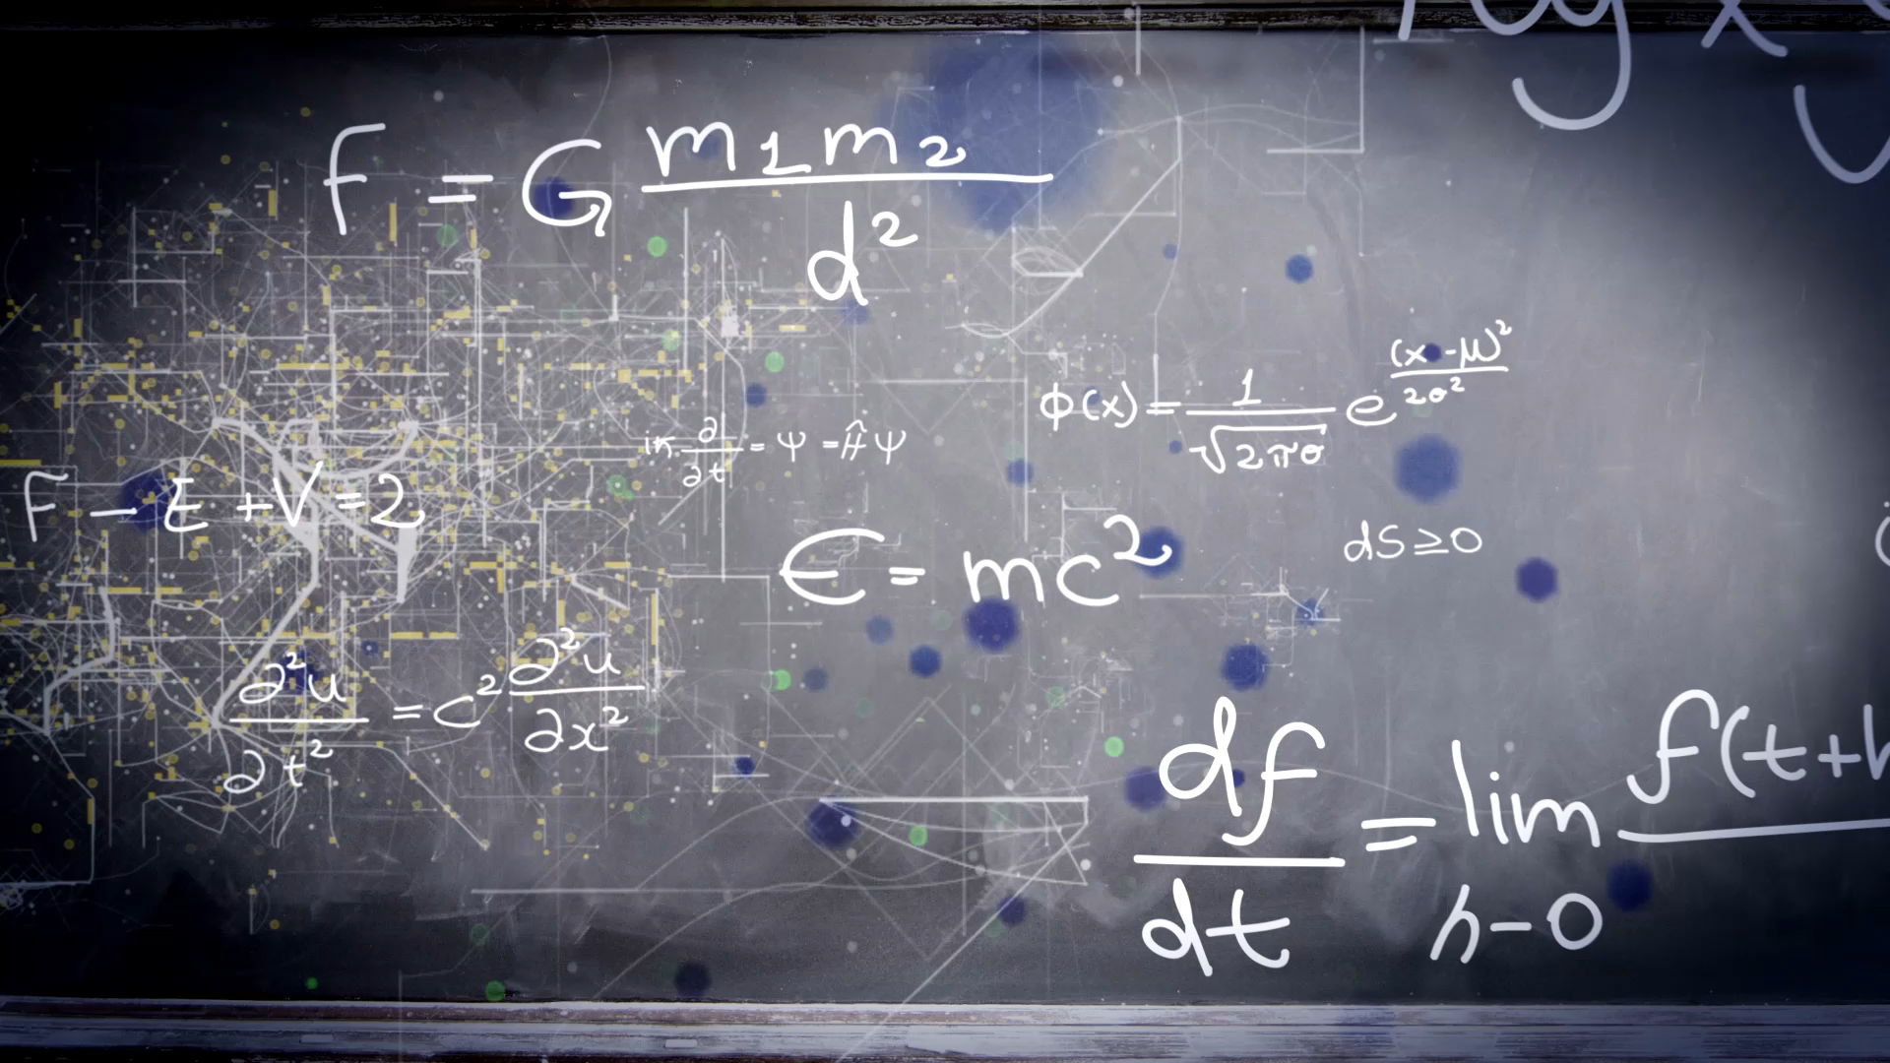
Show Up Your Skills

Slide 21
4 Methods to Show Up Your Skills
Skill based portfolio
End to end data science projects
Data science competitions
Data science blog

Slide 22
Skill-Based Portfolio
Define important skills you need to show
Build a small to medium size project using this tool or applying this skill
This can be course project or side project
Take step further

Slide 23
End to End Projects
Select
Select a domain of interest
Define
Define important case studies
Select
Select one case study
Collect
Collect data
Make
Make it end to end
Publish & talk about
Publish & talk about it

Slide 24
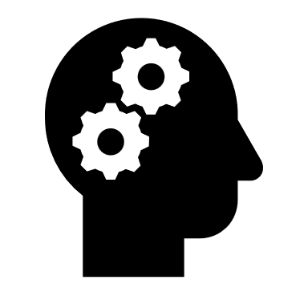





Approaching AI Projects
Identify a business problem (not an AI problem)
Brainstorm AI solutions
Assess the feasibility and value of potential solutions.
Determine Success metrics.
Budget for resources
Iterate

Slide 25

Identify A Business Problem
The first step is to identify a business problem. You can ask a domain expert and ask, “What are the top three things that you wish worked better? Why aren’t they working yet?”
You can search the case studies that companies are working on right now.

Slide 26

Brainstorm AI solutions
Once you understand a problem, you can brainstorm potential solutions more efficiently.
Sometimes there isn’t a good AI solution, and that’s okay too

Slide 27

Assess Feasibility & Values
You can determine whether an approach is technically feasible by looking at:
Published work
Competitors work & results
Perhaps building a quick proof of concept implementation.
Consulting with domain experts.

Slide 28

Determine Success Metrics
Once you’ve deemed a project sufficiently valuable, the next step is to determine the metrics to aim for. This includes both machine learning metrics (such as accuracy) and business metrics (such as revenue).

Slide 29

Budget For Resources
Think through everything you’ll need to get the project done including data, personnel, time, and any integrations or support you may need from other teams.

Slide 30

Iterate
Working on projects is an iterative process. If, at any step, you find that the current direction is infeasible, return to an earlier step and proceed with your new understanding.

Slide 31
Building a portfolio of projects, especially one that shows progress over time from simple to complex undertakings, will be a big help when it comes to looking for a job.
Andrew NG

Slide 32
Data Science Competitions
Participate in data science competitions on Kaggle, popular hackathons.
Try to be in top 10 %
Partcipate in only limited number of competitions!

Slide 33
Data Science Blog
Build a personal blog or on Medium
Build project and Describe the methodology
Story tell and communicate the results with the people

Slide 34

Land a Job

Slide 35




How to Land a Job?
Pay attention to the basics
Connect
Proceed respectfully and responsibly
Choose who to work with
Get help from your community

Slide 36




Keys to Building Successful Career
Teamwork
Communication
Networking
Personal discipline
Altruism

Slide 37

Final Thoughts

Slide 38
Overcoming Imposter Syndrome
AI is technically complex, and it has its fair share of smart and highly capable people. But it is easy to forget that to become good at anything, the first step is to suck at it.
Have supportive mentors or peers
No one is an expert at everything

Slide 39

Make Everyday Count
How many weeks is is a typical human lifespan?
How many days is a typical human lifespan?
How many hours is a typical is a typical human lifespan?

Slide 40


Thank You
Youssef Hosni
Youssef.Hosni95@outlook.com
LinkedIn | Medium | GitHub | YouTube

